Slide 1
PREETHI V
Final Project
3/21/2024 Annual Review

Slide 2
PROJECT TITLE
Customer Subscription Prediction for Subscription-Based
Services with Decision Trees
3/21/2024 Annual Review

Slide 3


AGENDA
1. Understanding the Problem:
gfdfgdtheprobls: Clearly articulate what you aim to achieve with customer subscription prediction.
Define success metrics: Determine how you'll measure the performance of your prediction model (e.g., accuracy, precision, recall).cc
1.Understanding the Problem:
2. Data Collection and Exploration:
3. Feature Engineering:
4. Splitting Data for Training and Testing:
5. Model Building:
6. Model Evaluation:
7. Interpretability and Visualization:
8. Model Deployment and Monitoring:
9. Iteration and Improvement:
10. Documentation and Knowledge Sharing:
3/21/2024 Annual Review

Slide 4

PROBLEM STATEMENT
The problem at hand is to develop a predictive model for customer subscription in subscription-based services using decision trees. Subscription-based services, such as streaming platforms, software-as-a-service (SaaS) products, or subscription boxes, rely on attracting and retaining subscribers to sustain their business model. Identifying potential subscribers and predicting their likelihood of subscribing is crucial for optimizing marketing efforts, resource allocation, and customer retention strategies.
3/21/2024 Annual Review

Slide 5

PROJECT OVERVIEW
The primary objective is to accurately predict whether a customer will subscribe to the service, utilizing historical customer data encompassing demographics, past interactions, and subscription status. Key steps include data collection, exploration, and preprocessing to clean and prepare the dataset. Feature engineering techniques are employed to create new features and select relevant ones to enhance model performance. Decision tree algorithms, such as CART or ID3, are implemented for model development, with hyperparameters tuned to optimize performance. Model evaluation involves assessing metrics like accuracy, precision, and recall, ensuring robustness through cross-validation. Interpretation and visualization techniques aid in understanding the model's decision-making process and identifying key drivers of subscription behavior.
3/21/2024 Annual Review

Slide 6

WHO ARE THE END USERS?
Product Development Teams: Product development teams can utilize insights from the model to enhance the service offerings or features that are most appealing to potential subscribers. By understanding the factors driving subscription decisions, they can prioritize product improvements that align with customer preferences and needs.
Sales Teams: Sales teams can leverage the predictions to prioritize leads and focus their efforts on prospects with a higher likelihood of subscribing. This can improve sales efficiency and effectiveness by directing resources towards the most promising opportunities.
Marketing Teams: Marketing teams can use the predictions generated by the model to target promotional campaigns more effectively. By identifying potential subscribers, they can tailor marketing messages and incentives to attract and convert these customer
3/21/2024 Annual Review

Slide 7
4.Customer Success Teams: Customer success teams can proactively engage with customers who are at risk of not subscribing or churning. By intervening early and addressing potential issues or concerns, they can improve customer retention and loyalty.
5.Business Analysts and Executives: Business analysts and executives can use the predictions to inform strategic decision-making and resource allocation. Insights from the model can help optimize budget allocation, forecast revenue, and assess the impact of marketing initiatives on subscription growth.
6.Data Scientists and Model Developers: Data scientists and model developers are involved in building, training, and maintaining the predictive model. They ensure that the model is accurate, robust, and aligned with the organization's objectives. They may also be responsible for monitoring model performance and making updates as needed.

Slide 8

YOUR SOLUTION AND ITS VALUE PROPOSITION
SOLUTION:
The Solution for Customer Subscription Prediction with decision trees is beginning with data collection, historical customer data, including demographics, past interactions, and subscription status, is gathered and preprocessed to handle missing values and encode categorical variables. Create new features and select based on their importance in predicting subscription behavior. Train the decision tree model on the preprocessed data, tuning hyperparameters for optimal performance. Conduct cross-validation to assess model generalization and robustness. Visualize decision trees to interpret and deploy the trained decision tree model for real-time predictions. Then, iterate the model based on feedback or new data ,incorporating additional features for enhanced prediction and document the entire model process.
3/21/2024 Annual Review

Slide 9

VALUE PREPOSITION:
Data-Driven Insights
Optimized Resource Allocation
Enhanced Customer Experience
Churn Mitigation
Business Growth:
Continuous Improvement:
Actionable Insights:
Documentation and Knowledge Sharing:

Slide 10

THE WOW IN YOUR SOLUTION
Personalized Precision: Our solution crafts hyper-personalized recommendations for each customer, leveraging advanced decision tree algorithms to predict subscription likelihood with unparalleled accuracy.
Real-Time Agility: Dynamic adaptation to evolving customer behaviors ensures our solution stays ahead of the curve, optimizing subscription strategies in real-time for maximum impact.
Insight Unleashed: Cutting-edge feature engineering techniques uncover hidden patterns, empowering businesses to anticipate future subscription trends with precision.
Seamless Integration: Seamlessly integrated into existing workflows, our solution provides actionable insights at every touchpoint, driving immediate results without friction.
3/21/2024 Annual Review
10

Slide 11

5.Transparent AI: Transparent and explainable AI fosters trust and confidence, demystifying the decision-making process for stakeholders and ensuring widespread adoption.
6.Continuous Improvement: Constant learning from new data and feedback ensures our solution evolves over time, getting smarter and more effective with each iteration, leading to sustainable growth and success.

Slide 12
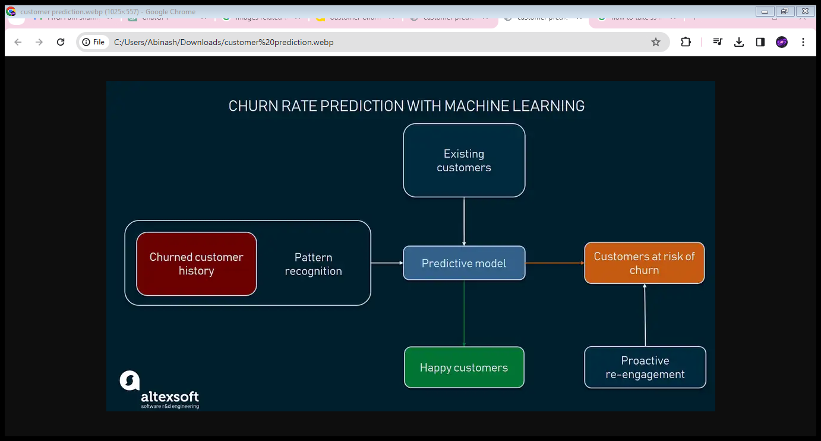
MODELLING
3/21/2024 Annual Review
12

Slide 13
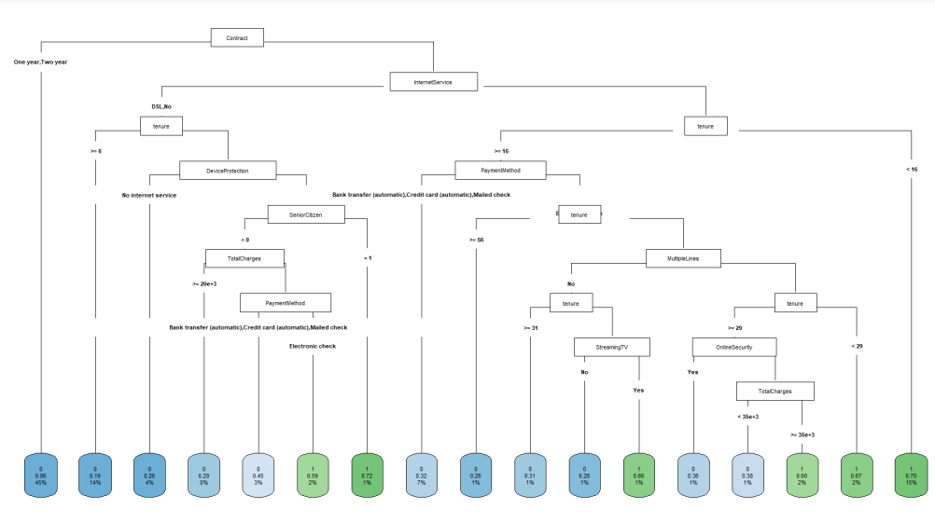

Slide 14
RESULTS
Confusion Matrix:
A matrix showing the counts of true positive, true negative, false positive, and false negative predictions, allowing for a more detailed understanding of model performance.
Model Performance Metrics:
Accuracy: The proportion of correctly predicted subscriptions.
Precision: The proportion of true subscriptions among all predicted subscriptions.
Recall: The proportion of true subscriptions that were correctly predicted.
F1-score: The harmonic mean of precision and recall, providing a balanced measure of model performance.
Demo Link
3/21/2024 Annual Review
14

Slide 15
3.Feature Importance:
A ranking of features based on their importance in predicting subscriptions, providing insights into the key drivers influencing subscription behavior.
4.Visualized Decision Tree:
A visual representation of the decision tree model, illustrating the decision-making process and criteria used to predict subscriptions.
5.Prediction Results:
Predicted subscription status for individual customers in the validation or test dataset, allowing for evaluation of specific predictions and comparison with actual subscription outcomes.
6.Business Insights:
Interpretation of model results and insights into actionable strategies for improving subscription rates, optimizing marketing efforts, and enhancing customer retention.

